Slide 1

Weather Patterns
Data Analytics and Visualization Final Project
John Bates | Brittany Woolard | Danielle Duce | Lakenia Manago
Notes:
Lekenia

Slide 2
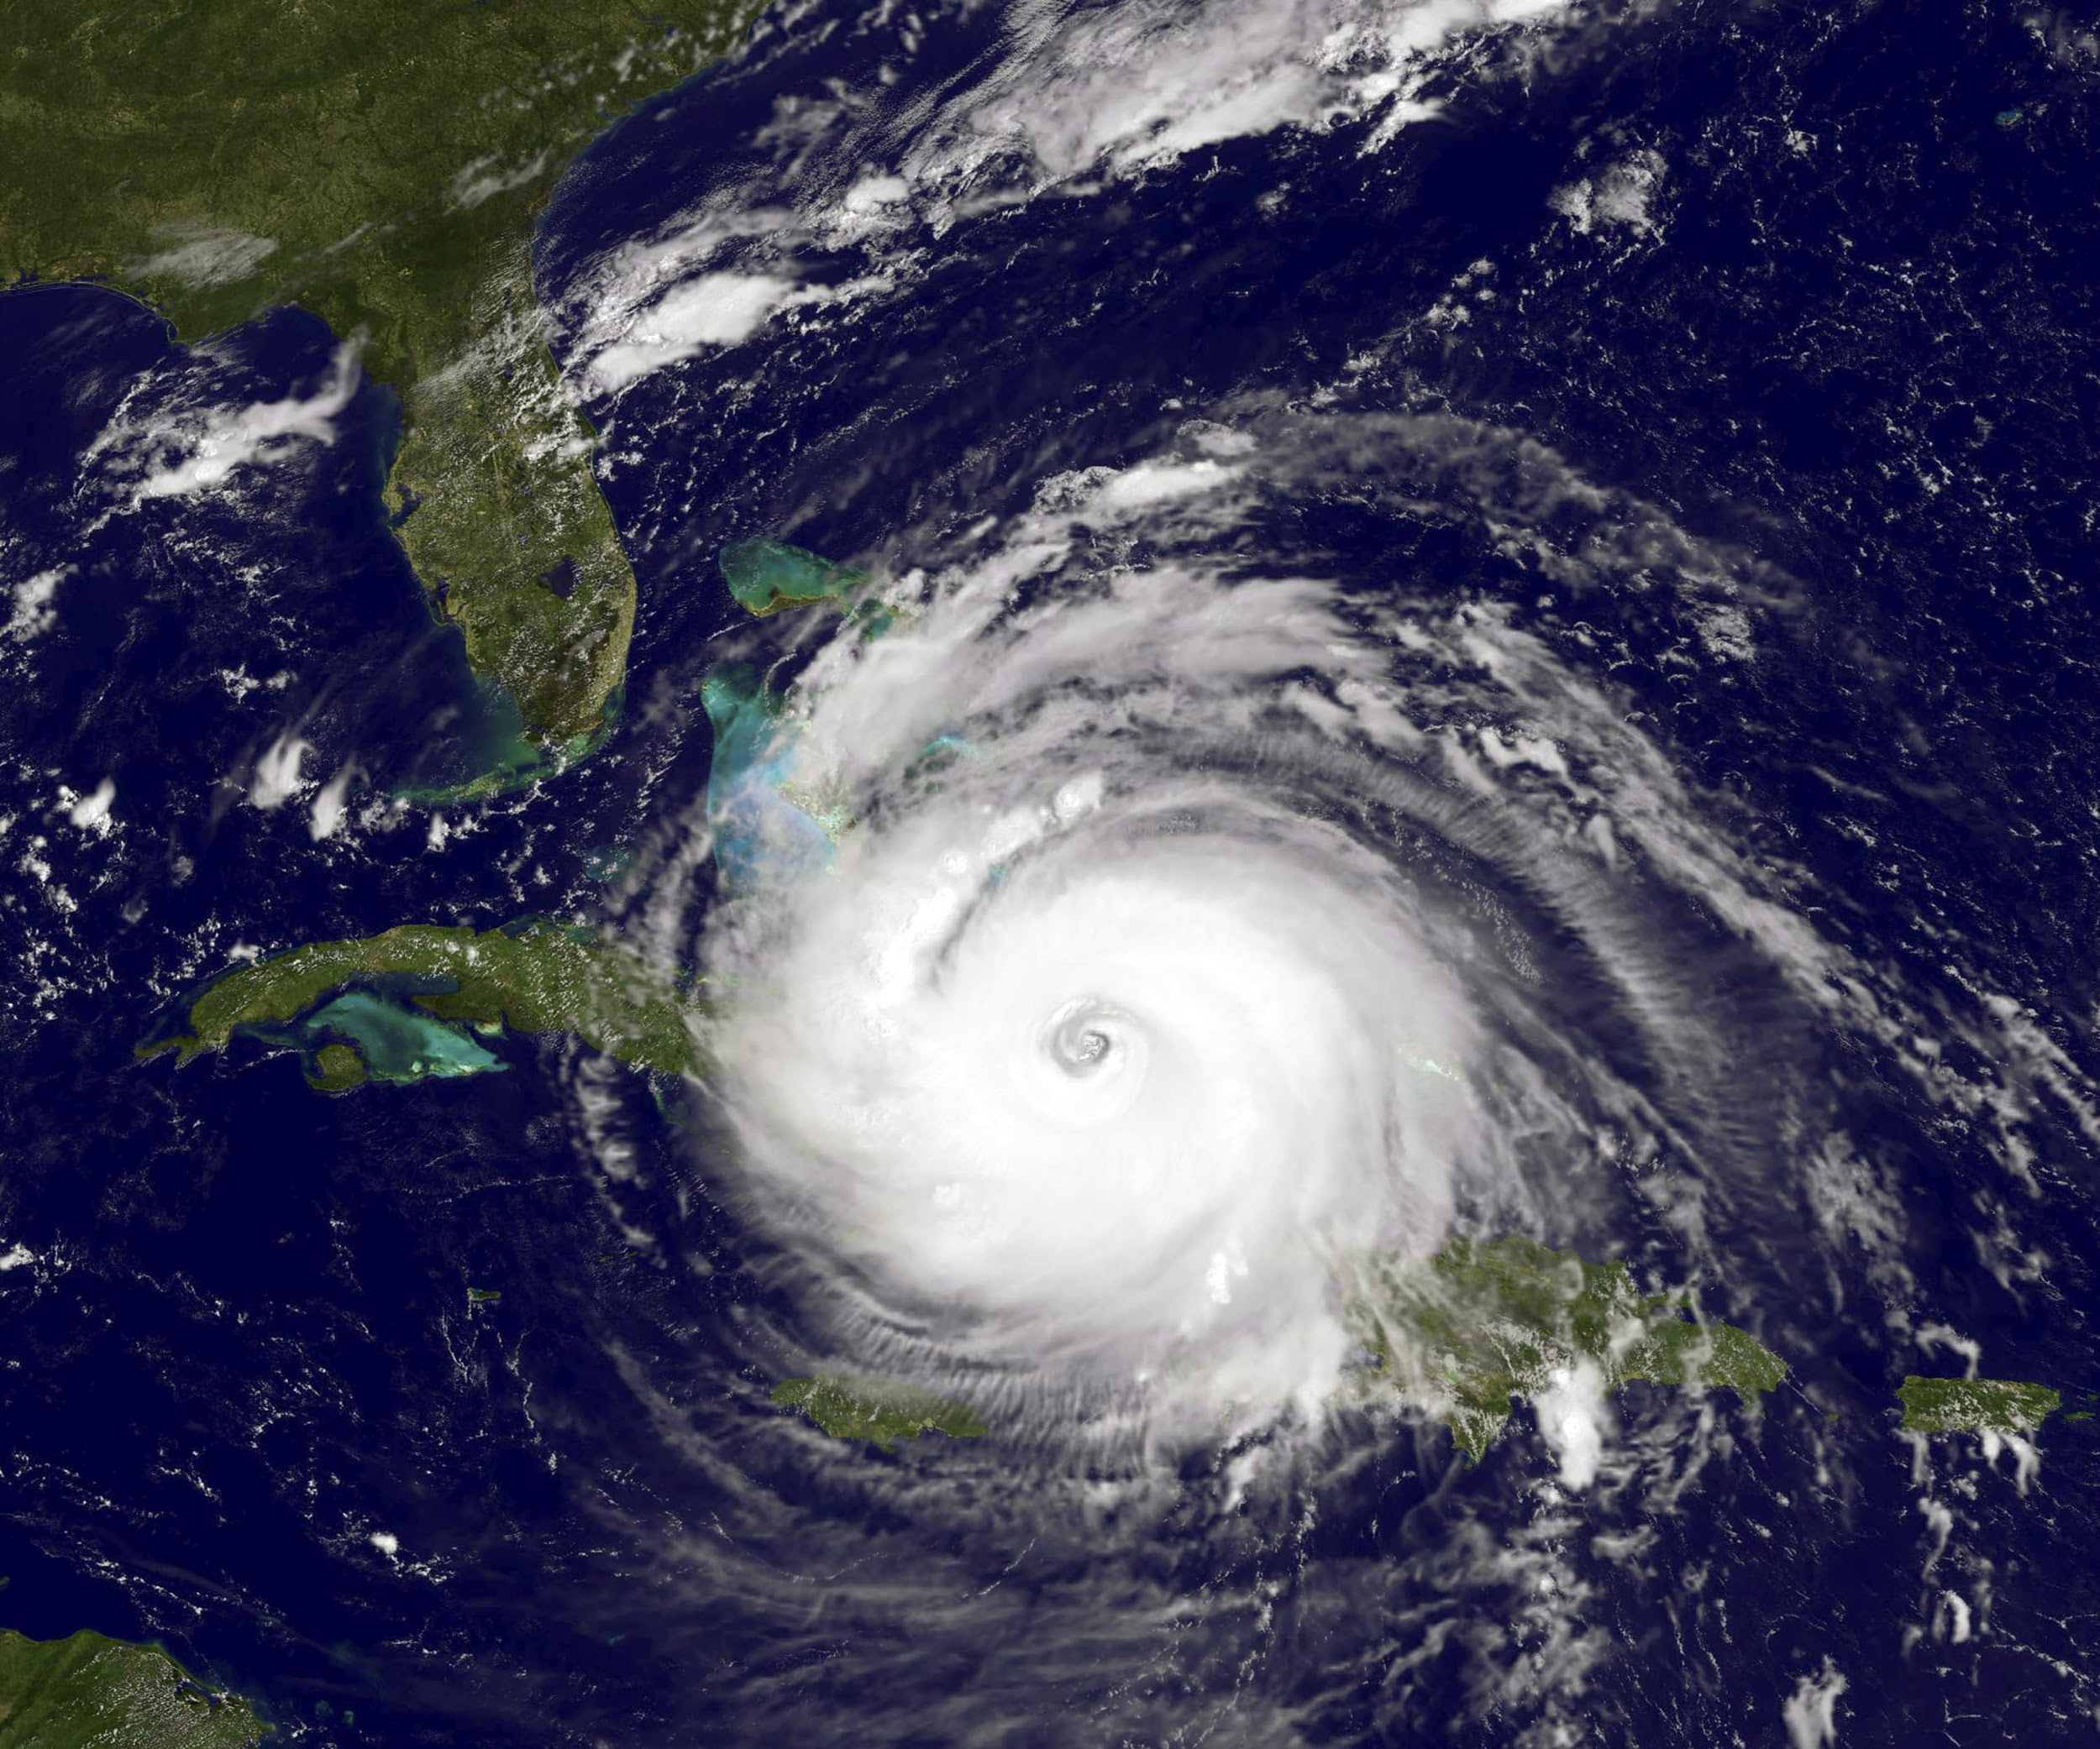
Agenda
Purpose & Data Exploration
Data Preprocessing & Structure
Database Structure & Creation
Data Analysis & Machine Learning
Visualizations and Dashboard
Tools & Recommendations
Notes:
Lekenia

Slide 3

Purpose
Analyze weather patterns among the east coast
Predict the likelihood of bad weather
Determine factors contributing to storm strikes in Florida
Provide analysis for meteorologists
Notes:
Lekenia

Slide 4
Data Exploration Phase
Questions we want to answer
What factors contribute to storm strikes in Florida?
What weather patterns do we observe with our data?
Finding the best data that fits our needs
How do we filter our data to suit our analysis?
What database structure can we use to present our findings?
What are the optimal tools to present our data?
Notes:
Lekenia

Slide 5
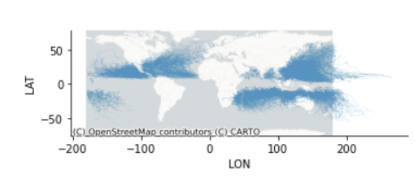
Data Preprocessing
Data Sources:
Storm Events DB from NOAA.gov (CSV file)
Geojson of US states from GitHub
Preprocessing steps:
Data files are imported to Pandas dataframes.
Unnamed storms are dropped from dataframe.
Data is mapped in Pandas to view data points.
Notes:
John
Storm DB all tropical storms since 1980, has a row for each storm every 3 hours, data includes year, basin, time, nature, lat, long, speed, direction.
Target geojson is Florida. NOAA - National Oceanic and Atmospheric Administration

Slide 6

Data Preprocessing
Preprocessing steps (cont.):
Geohash columns are created for latitude and longitude coordinates using pygeohash.
Geohash encodes a geographic location into a string of letters and digits.
The length of the geohash determines the area covered by the geohash.
In our analysis we are using the following geohash lengths.
Geohash Level | CellWidth | Cell Height
2 | 1,250 km | 625 km
5 | 4.89 km | 4.89 km
Notes:
John
Geohash levels go up to 12. Level 12 - 18.6mm, level 5,000 km

Slide 7
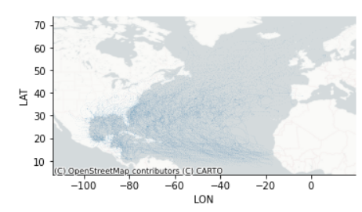
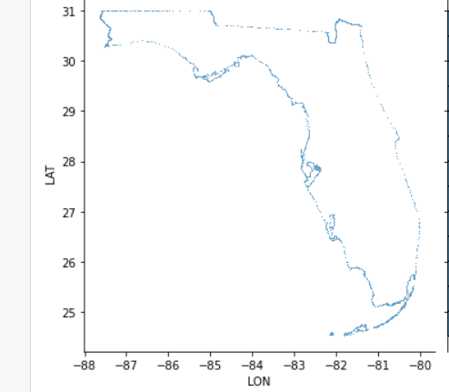
Data Preprocessing
Preprocessing steps (cont.):
Dataframe is filtered to the North Atlantic region.
Florida geojson file is imported to Pandas.
Florida geohash values are calculated.
Dataframes are exported to Postgres for DB processing.
Notes:
John

Slide 8
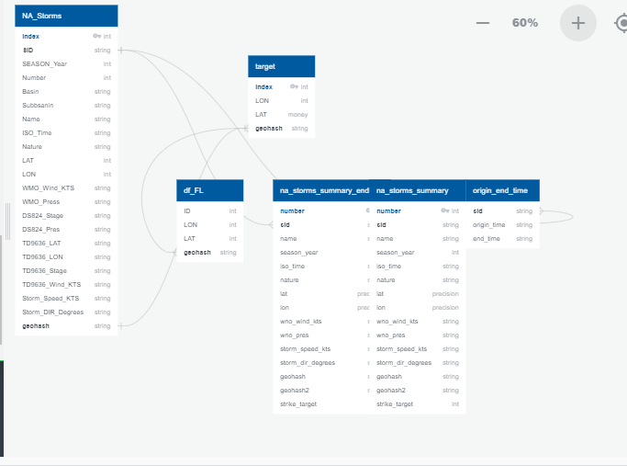
Database Structure
Entity Relationship Diagram
Notes:
John

Slide 9
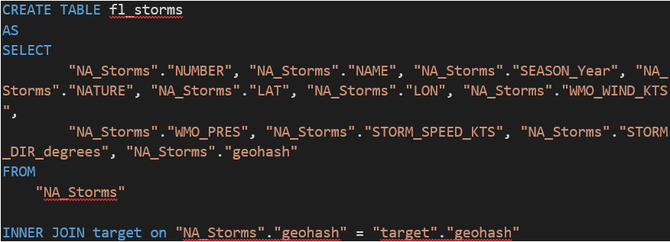
Database Structure
NA_Storms and Target tables are imported from Pandas
Fl_storms - created with the following query
Notes:
John
Inner join on geohash to determine storms that strike the target area.

Slide 10
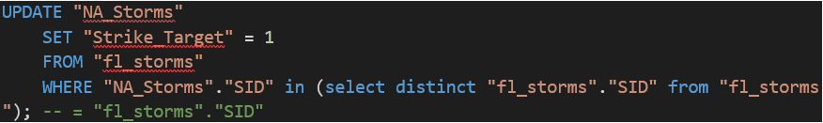
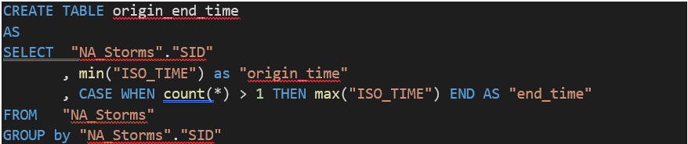
Database Structure
Strike Target
Origin_end_time
Notes:
John
Set value of “Strike_Target” to 1 if exists in “fl_storms” table. Note, a 1 in the
Strike_Target column indicates a storm strike in the target area
Origin_end_time takes the first and last posting for each storm ID by timestamp.

Slide 11
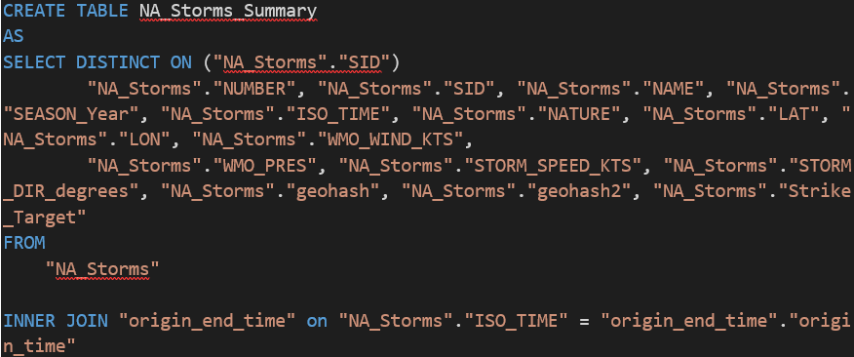
Database Structure
NA_storms_summary
NA_storms_summary_endtime
Notes:
John
Summary tables take the first entry for each storm from NA_storms table based on the origin time.
Summary tables are imported back to pandas and exported to csv files for machine learning and visualization.

Slide 12
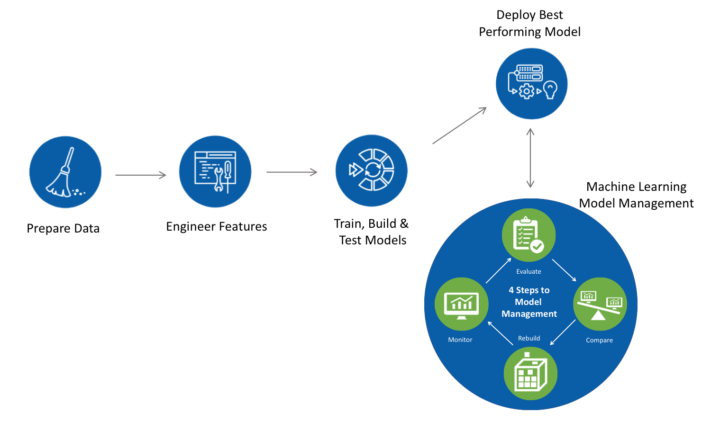
Machine Learning Pipeline
Notes:
Brittany

Slide 13
Data Analysis
Machine Learning Model
Steps in Logistic Regression : Below steps are required in development of our model
●Data Preprocessing
●Exploratory Data Analysis
●Feature Scaling
●Logistic Regression
●Predicting the Test Result
●Test Accuracy of Model
Our data has been prepared in earlier slide, we perform few additional steps to enable our dataset fit in to the model
Notes:
Brittany

Slide 14
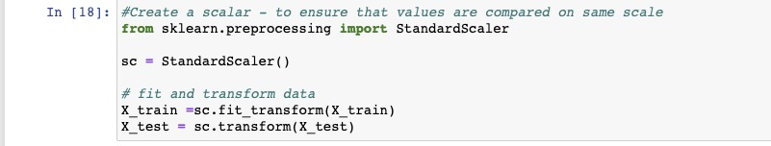
Data Analysis
Feature Scaling
Helps to normalize range of our features in our data.
Need to scale the data so our machine learning model can interpret these features on the same scale
Notes:
Brittany
Based on the Logistic Regression Learning Model we have an accuracy score of 70%. For this machine learning model we used sklearn.preprocessing.

Slide 15
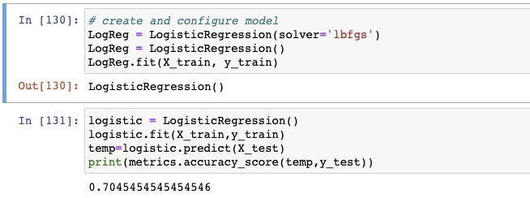
Data Analysis
Logistic Regression Model
Split Data
Model
Accuracy of logistic regression classifier is 70 percent
Notes:
Brittany
Based on the Logistic Regression Learning Model we have an accuracy score of 70%. For this machine learning model we used sklearn.preprocessing.

Slide 16
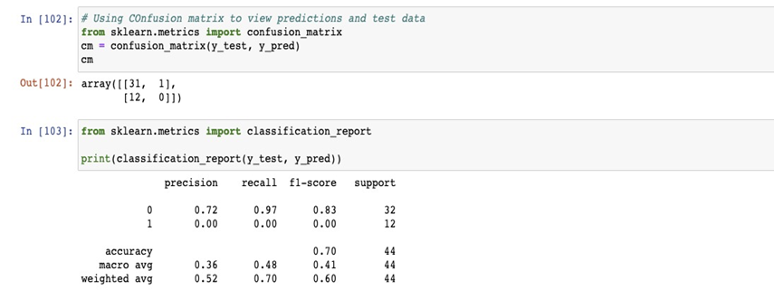
Data Analysis
Testing Accuracy of Model
Confusion matrix was used to test accuracy of our classification
Notes:
Brittany

Slide 17
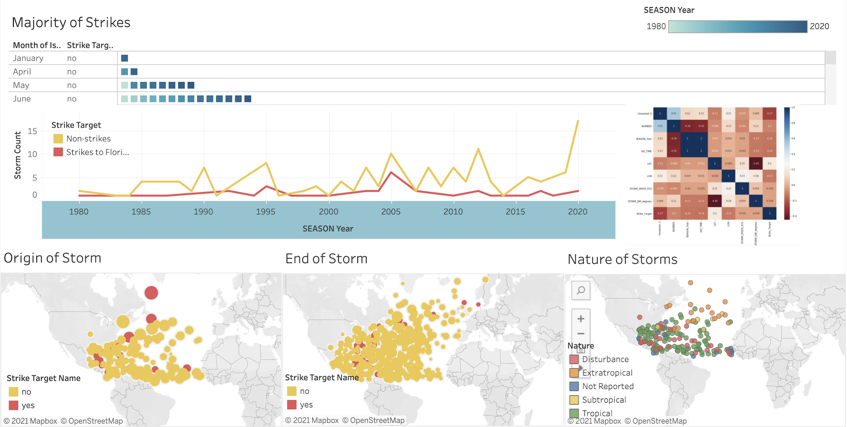
Data Analysis
Visualize the Data
Tableau Dashboard
Notes:
Storm Strike Dashboard Link
Danielle

Slide 18
Tools Used
Preprocessing
Pandas, Numpy, CSV
Matplotlib, Geopandas
Seaborn, Contextily
Pygeohash, Polygeohasher
Creating Database
PostgresSQL
Connecting to Database
SQLAlchemy, Psycopg2 module
Machine Learning
Sklearn.preprocessing
sklearn.metric
Dashboard
Tableau
Notes:
Danielle

Slide 19
Recommendations for Future Analysis
Explore other features for correlation
Make other analysis based on the severity of the storm
Notes:
Danielle

